Slide 1


LINUX
STORAGE
PRESENTED BY
ADMINISTRATION
MAYURI
RANI
TEJAS
YUGANDHAR
ADITYA
SIDDHARTH
IMRAN
PROJECT (P1)
PROJECT GUIDE
ZAKIR HUSSAIN

Slide 2



1
Introduction
6
Types Of Storage
2
System Requirements
7
Recovery and Backup
Presentation
Outline
3
8
Conclusion
Creating and Managing Partitions
4
LVM Management
5
RAID Configuration

Slide 3

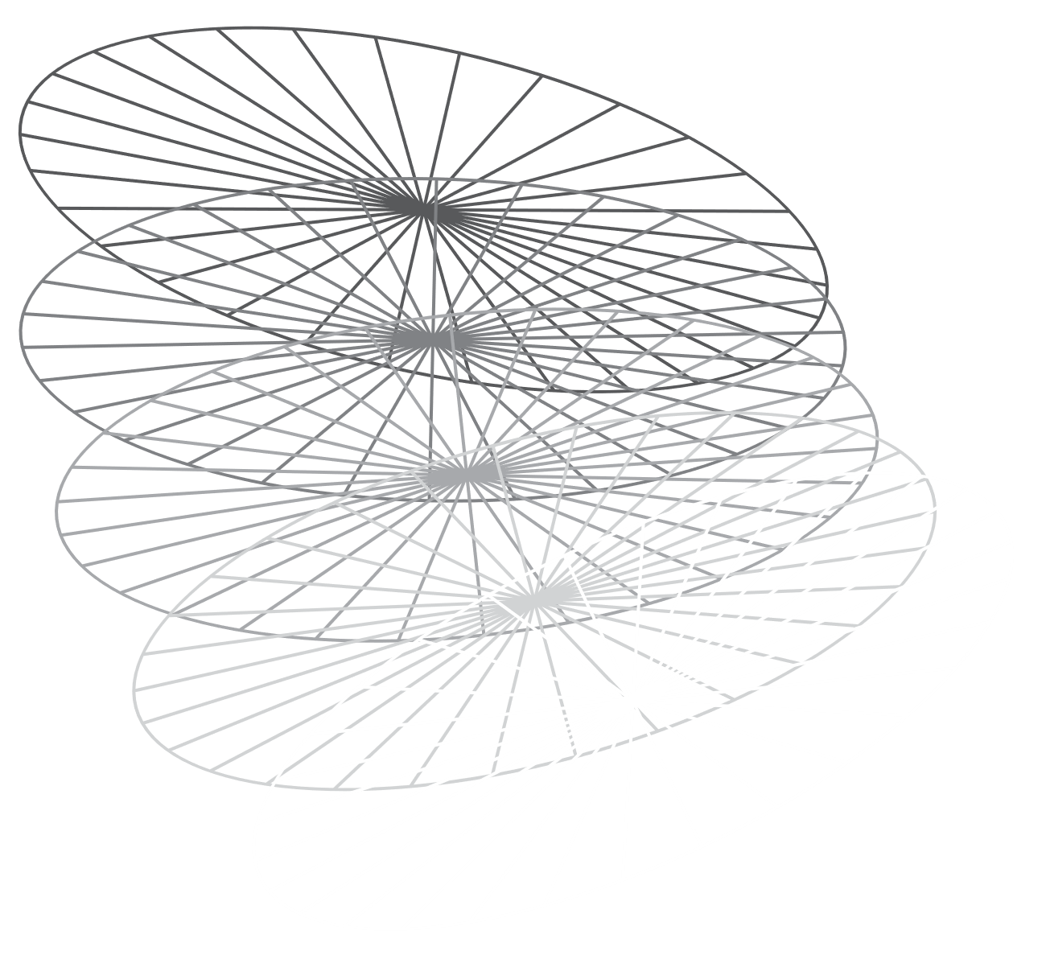
INTRODUCTION
WHAT IS LINUX?
Open Source 2. Kernel-Based 3. Multiuser and Multitasking 4. Security 5.Community Support
Objective: The objective of this project is to demonstrate proficiency in managing and administering storage in a Linux environment using CentOS."
Scope: The scope includes a variety of tasks and responsibilities such as:
Disk and File System Management.
Logical Volume Management (LVM).
RAID Configuration and Management.
Types of storage (SAN, DAS, NAS).
Backup and Recovery.

Slide 4

SYSTEM REQUIREMENTS
Hardware Requirements
Processor: Multi-core processor (e.g., Intel Core i3 or above)
RAM: Minimum 4 GB (8 GB or more recommended for better performance)
Disk Space: Minimum 20 GB for the operating system and project-related files.
Additional disk(s) for practicing storage management (e.g., 10 GB or more for partitioning and LVM tasks).
Network Connectivity: Internet connection for downloading necessary packages and updates.
Physical or Virtual Environment: A physical machine or virtual machine (VM) setup using software like VMware, VirtualBox, or a cloud-based environment like AWS EC2.
Software Requirements
Operating System:
CentOS 7 or CentOS 8 (other RHEL-based distributions can also be used).
Packages and Tools:
lvm2: For Logical Volume Management (LVM) tasks.
xfsprogs and e2fsprogs: For creating and managing xfs and ext4 file systems.
mdadm: For managing RAID configurations (optional, if RAID setup is part of the project).
quota package: For disk quota management.
parted or fdisk: For disk partitioning.
Text Editor:
vim, nano, or any preferred text editor for editing configuration files such as /etc/fstab.
Additional Tools:
htop or top: For monitoring system resource usage.
df, du, lsblk: For disk usage and block device information.

Slide 5

Creating and Managing Partitions
Disk Partitioning is the process of dividing a disk into one or more logical areas, often known as partitions, on which the user can work separately. It is one step of disk formatting. If a partition is created, the disk will store the information about the location and size of partitions in the partition table. With the partition table, each partition can appear to the operating system as a logical disk, and users can read and write data on those disks. The main advantage of disk partitioning is that each partition can be managed separately.

Slide 6
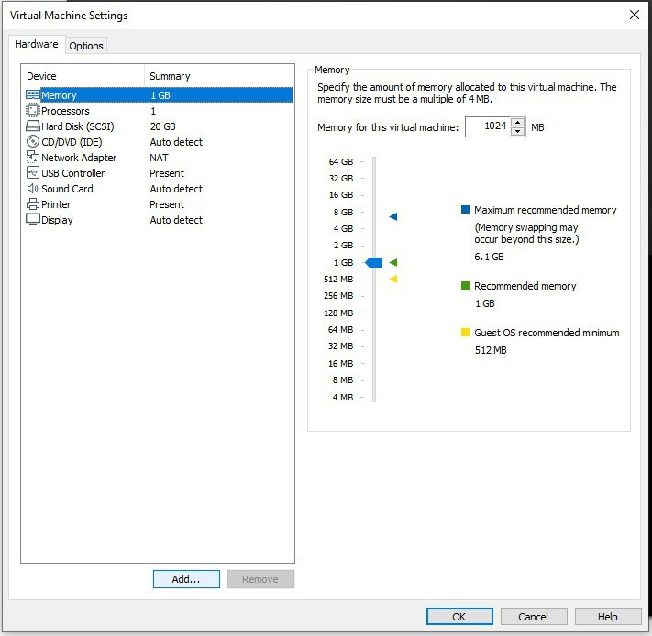
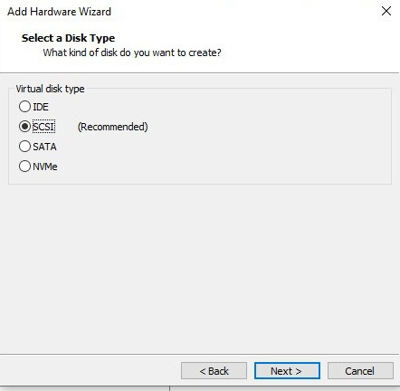
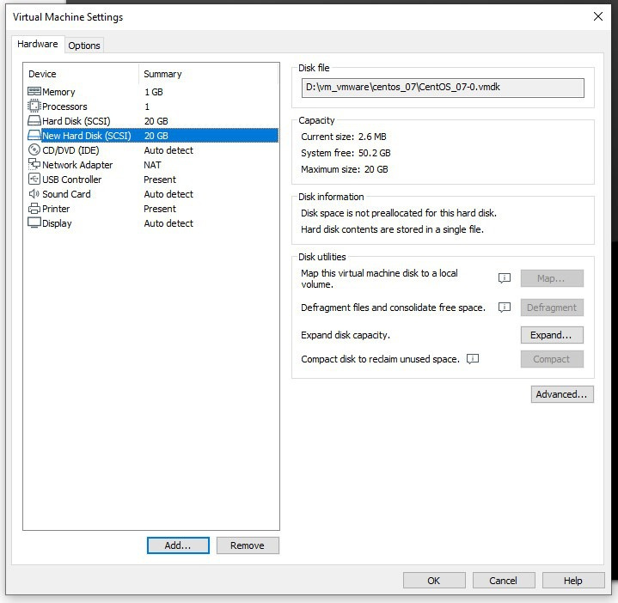
OUTPUT

Slide 7

LVM Management
LVM (Logical Volume Manager) is a system used for managing disk storage in a more flexible and efficient way compared to traditional partitioning. It allows for dynamic resizing, creation, and management of logical volumes, which can be used in place of conventional disk partitions.
Key Concepts of LVM:
1 Physical Volumes (PVs):
These are the actual storage devices, such as hard drives or partitions, that LVM uses. You can combine multiple physical volumes into a pool of storage.
2 Volume Groups (VGs):
A volume group is created by combining one or more physical volumes. It acts as a pool of storage space from which logical volumes can be allocated.

Slide 8
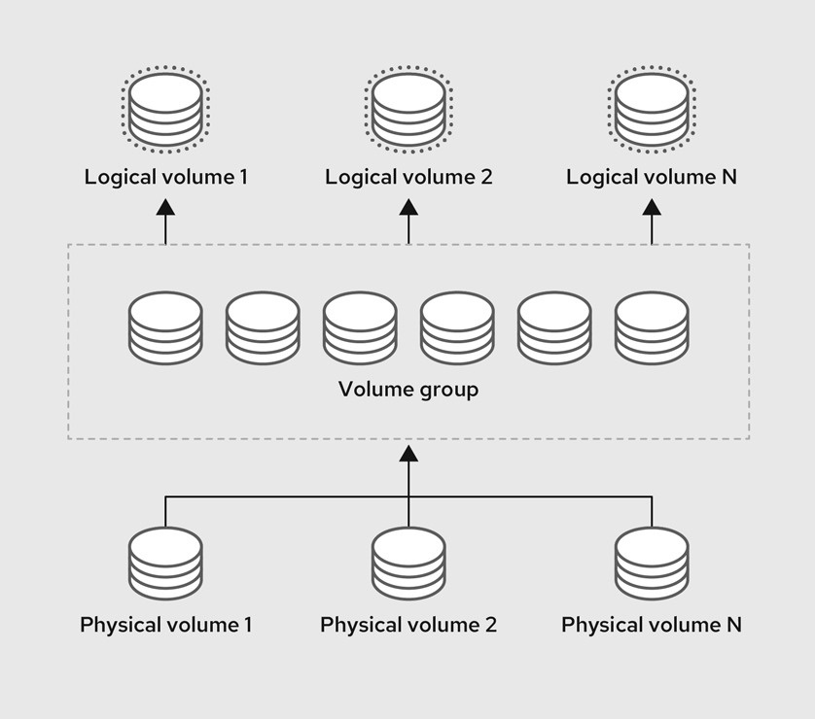

3 Logical Volumes (LVs):
Logical volumes are created within a volume group and are similar to partitions but much more flexible. You can resize, create, or remove logical volumes without worrying about the physical layout of the storage.

Slide 9
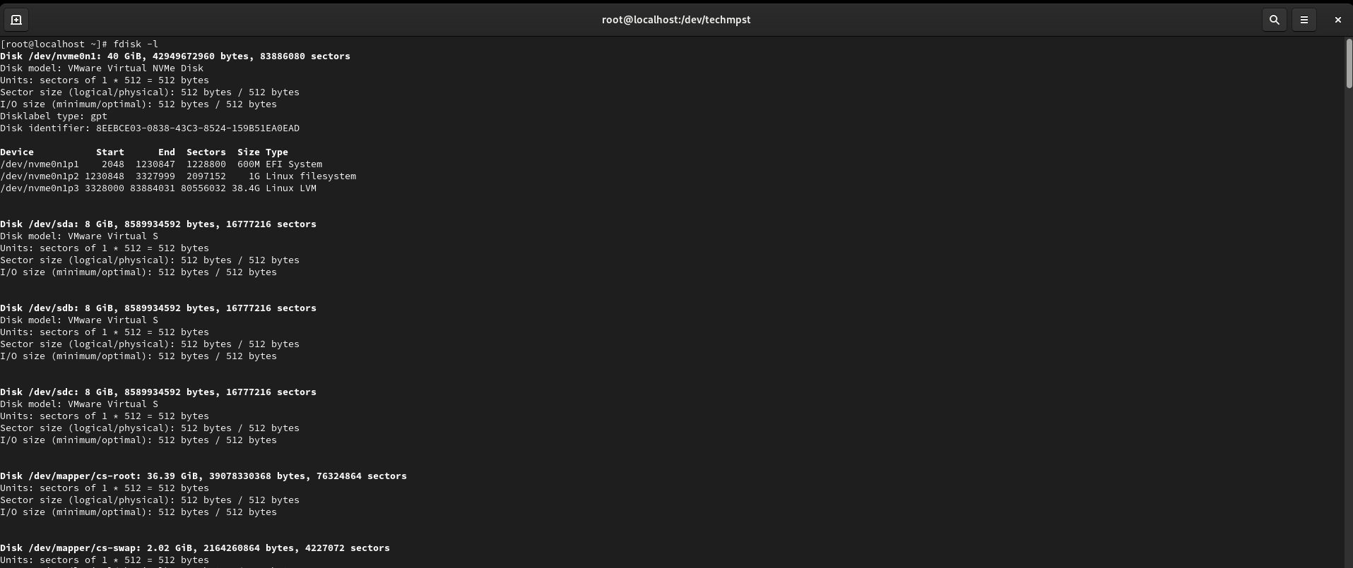
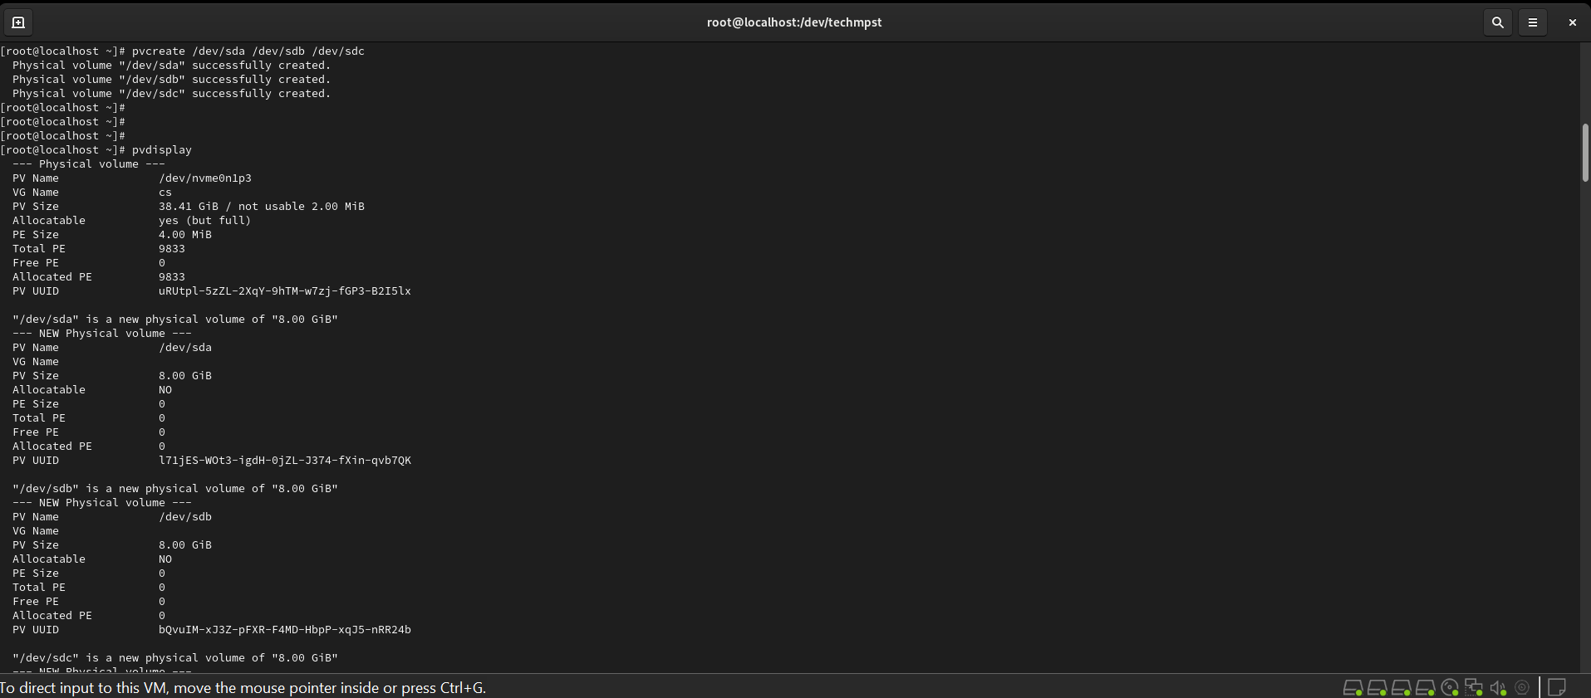
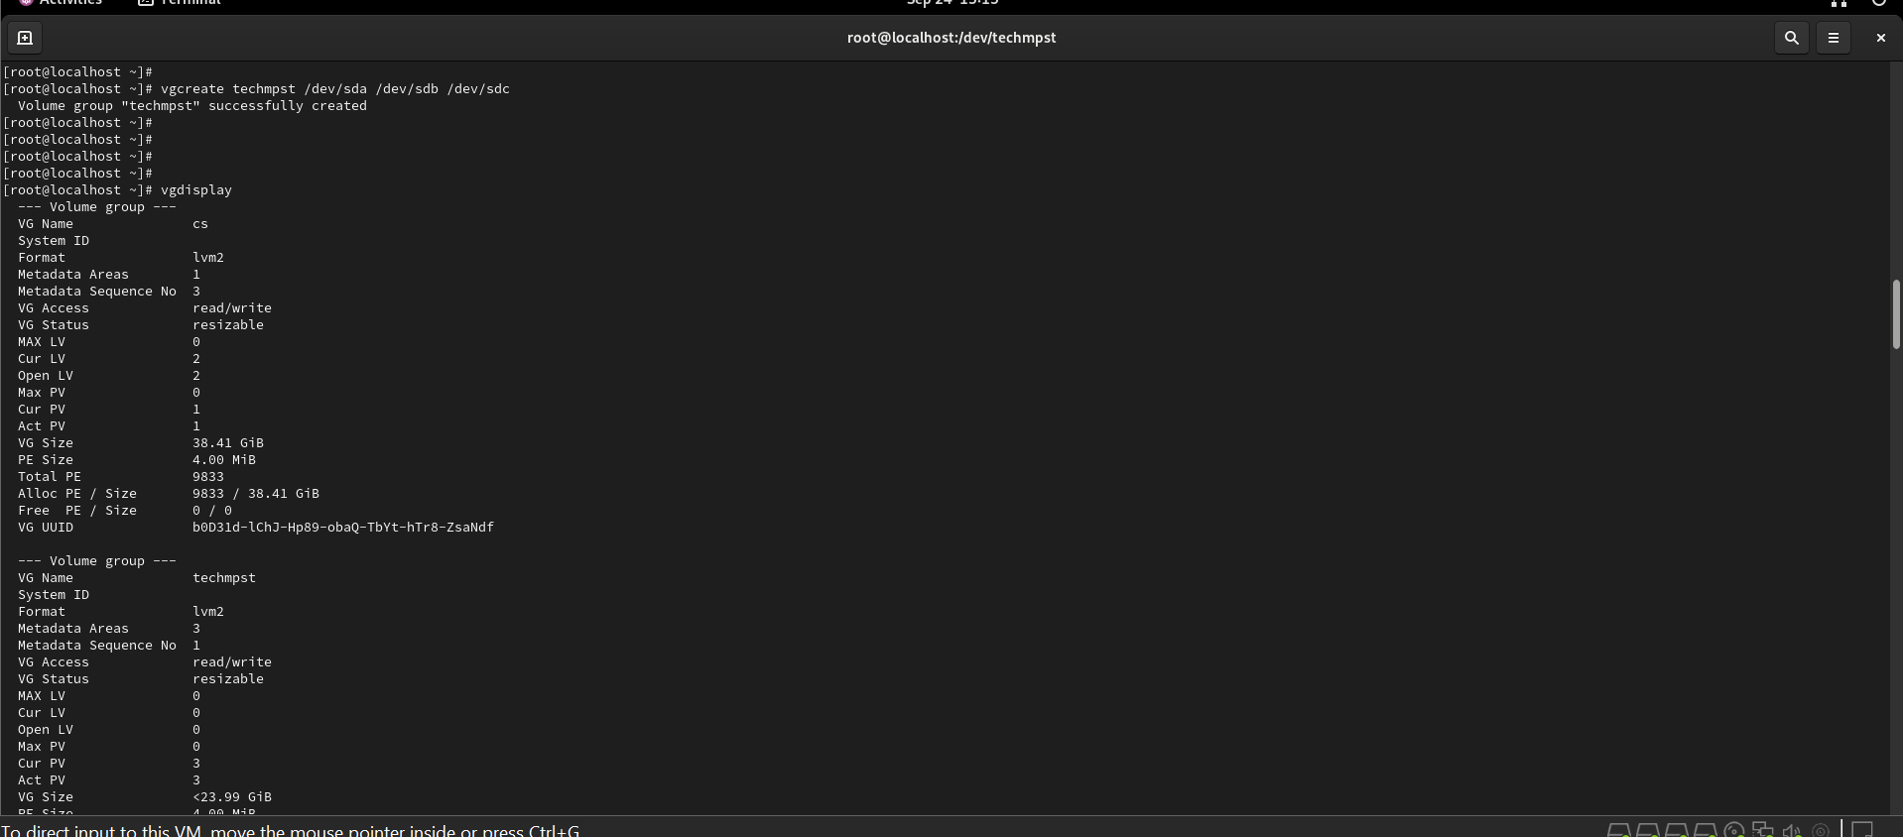
OUTPUT

Slide 10
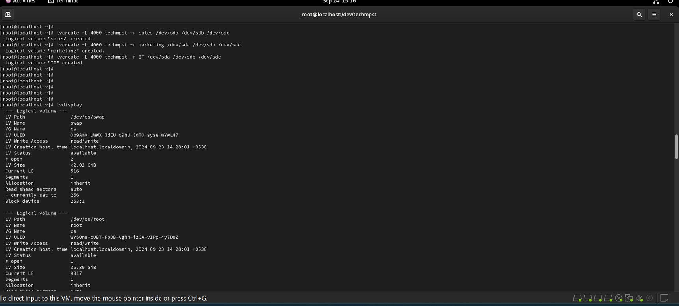
OUTPUT

Slide 11

RAID
Raid contains groups or sets or Arrays. A combine of drivers make a group of disks to form a RAID Array or RAID set. It can be a minimum of 2 number of disk connected to a raid controller and make a logical volume or more drives can be in a group. Only one Raid level can be applied in a group of disks. Raid are used when we need excellent performance. According to our selected raid level, performance will differ. Saving our data by fault tolerance & high availability.
RAID 0 (Striping):
* Concept: Data is split into blocks and written across multiple disks in a striped pattern. For example, block 1 goes to disk 1, block 2 goes to disk 2, block 3 goes to disk 1, and so on. This allows for parallel read/write operations, significantly boosting performance.
* Strengths:
* High Performance: Offers the fastest read and write speeds among RAID levels.
* Easy Setup: Relatively simple to configure.

Slide 12

RAID 1 (Mirroring):
* Concept: Data is duplicated exactly onto two or more disks. Any write operation is applied to all disks in the array.
* Strengths:
* High Reliability: Offers excellent data protection. If one disk fails, the other takes over seamlessly.
* Fast Read Operations: Reads can be served from either disk, improving read performance.
RAID 4 (Striping with Dedicated Parity Disk):
* Concept: Data is striped across multiple disks, and a dedicated disk is used for parity information. The parity disk stores a parity block that allows for data recovery if a data disk fails.
* Strengths:
* Good Read Performance: Read operations are fast since the parity disk is not involved in reading.
* Fault Tolerance: Can tolerate one disk failure.

Slide 13

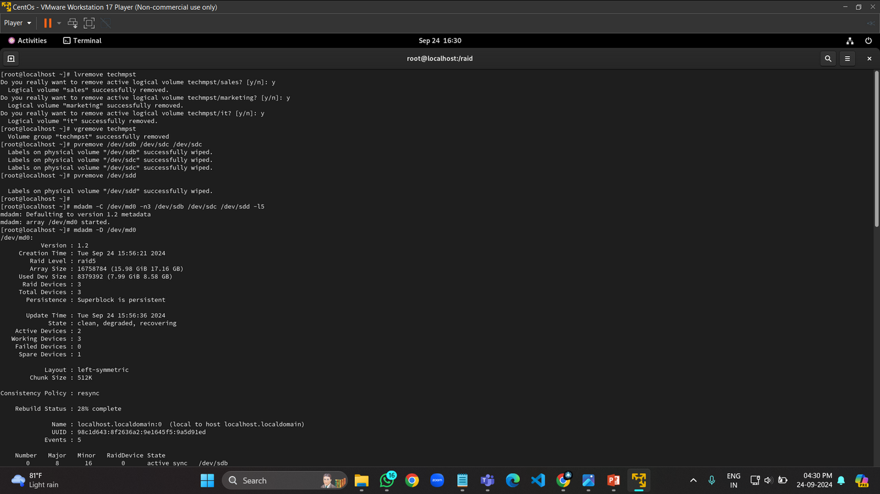
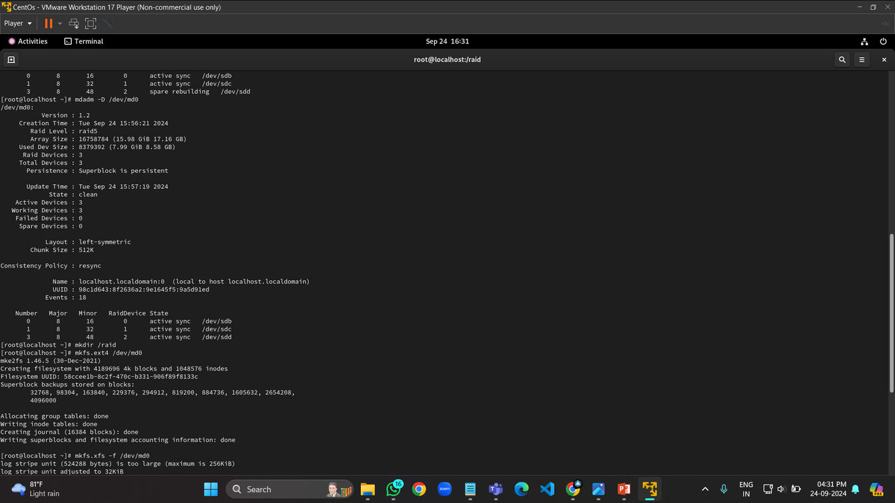
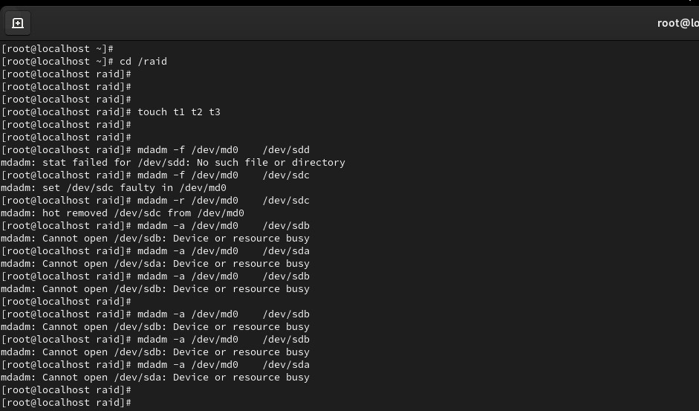
RAID 5 (Striping with Distributed Parity):
* Concept: Data is striped across multiple disks, and a parity block (calculated from the data) is distributed across all disks. The parity block enables data recovery if a disk fails.
* Strengths:
* Good Performance: Offers a good balance of performance and reliability.
* Fault Tolerance: Can tolerate one disk failure.
* Efficient Disk Utilization: Uses disk space more efficiently than RAID 1, with a smaller overhead for parity.

Slide 14
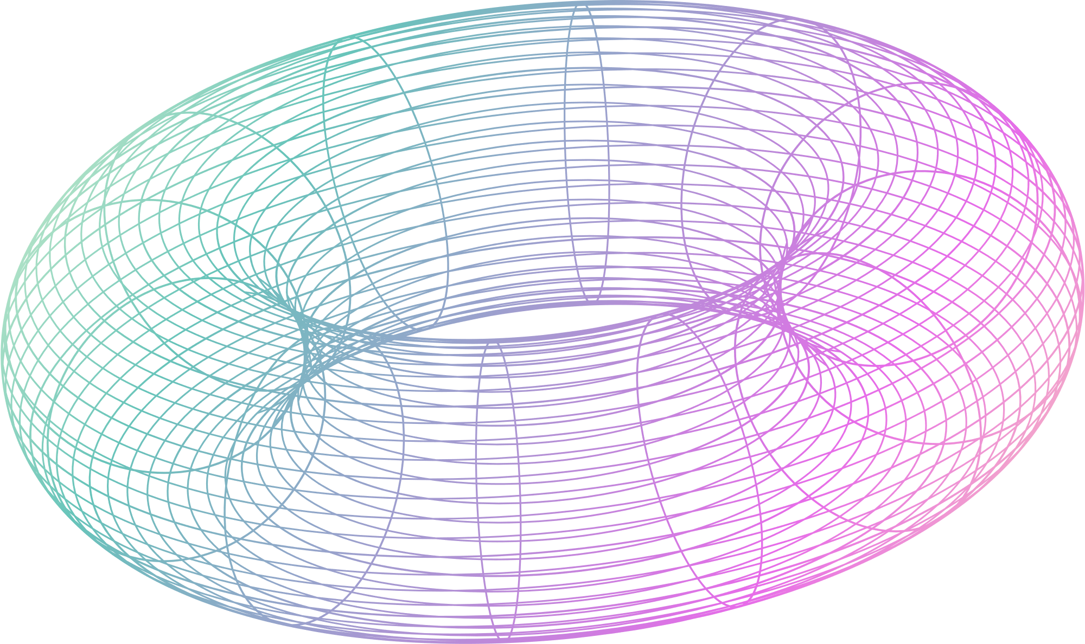
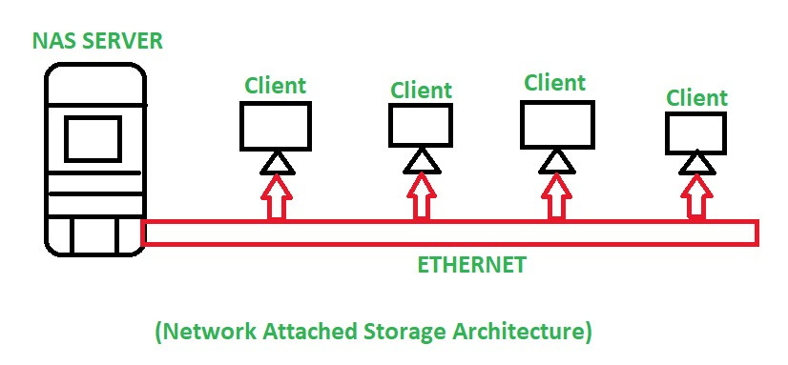
TYPES OF STORAGE:
Network Attached Storage(NAS)
- NAS Storage Device is attached on the Local Area Network
- NAS used for sharing of data among different users attached to the Local Area Network
- NAS system is having its own file system
- This type of network requires a medium for attaching with several computers
- File sharing protocols like NFS, AFP, or CIFS provide access to files in a network.

Slide 15
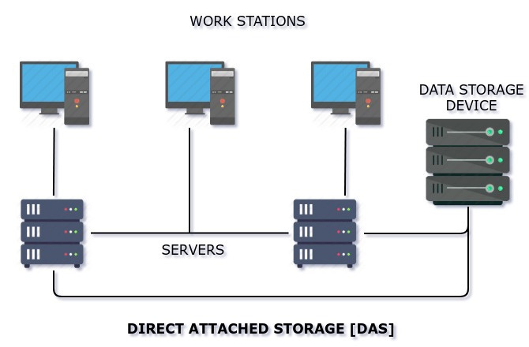
2) Direct Attached Storage (DAS) :
- It is a digital storage device connected directly to the server, workstation, or personal computer via the cable
- Direct Attached Storage, applications use the block-level access protocol for accessing the data.
- There is no need for any network to attach the device to the server or workstation.
- The System of DAS is attached directly to the computer through the HBA.

Slide 16
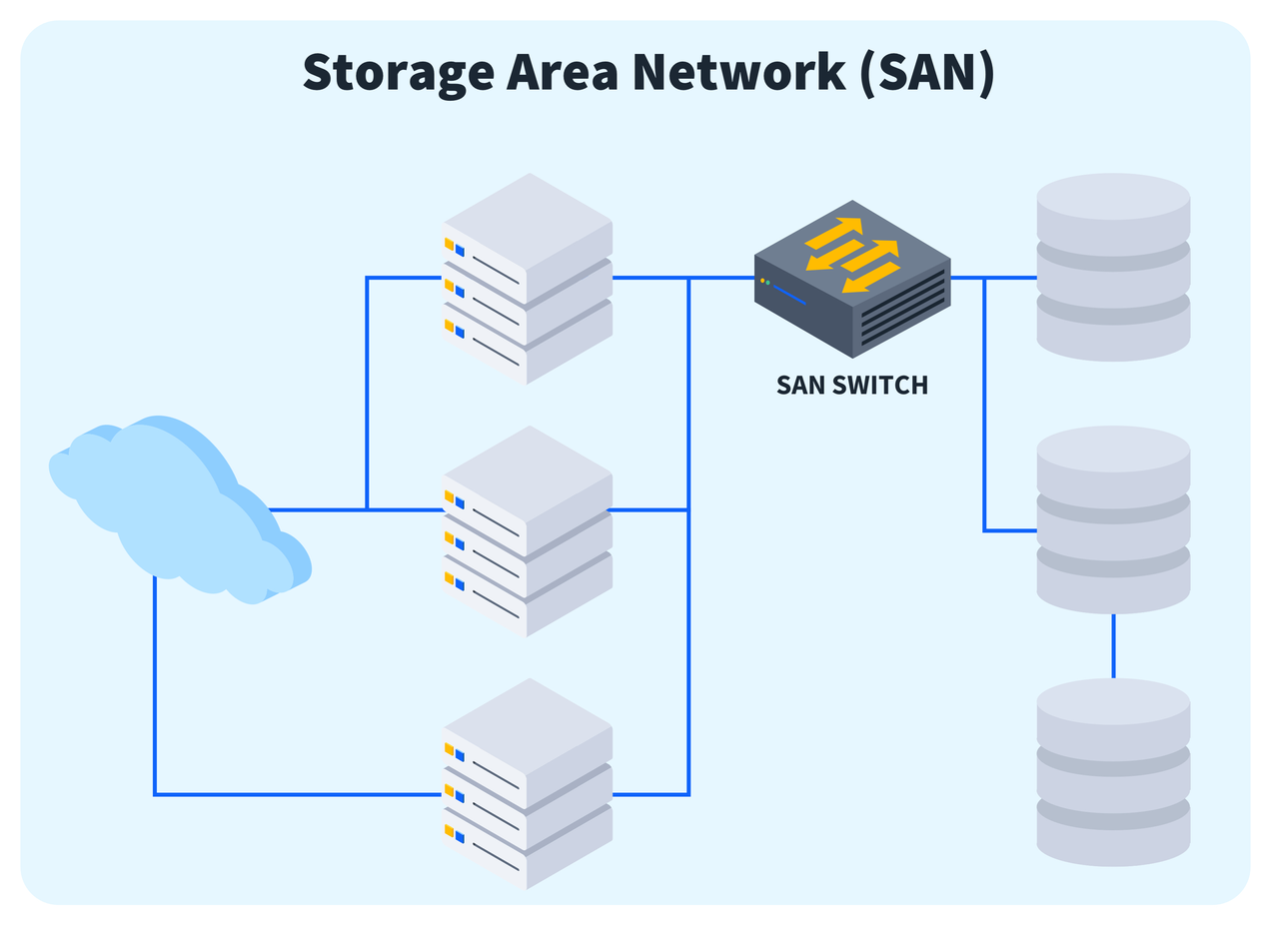
3)Storage Area Network (SAN)
SAN is a high-speed network that provides access to consolidated block-level storage. It is typically used in enterprise environments.
Pros: High performance and scalability. It supports advanced features like clustering and disaster recovery.
Cons: Expensive and complex to set up and manage. Requires specialized hardware and expertise.

Slide 17

Recovery and Backups
Incremental Backup
Differential Backup
Full Backup

Slide 18
CONCLUSION
The Linux Storage Administration project has provided valuable insights into the critical role of managing and configuring storage systems in a Linux environment. Throughout the project, we explored essential storage management techniques, including disk partitioning, Logical Volume Management (LVM), file system creation, and disk quota configuration. Each of these tasks demonstrated the practical application of administrative commands and best practices necessary for maintaining a reliable and efficient storage infrastructure

Slide 19
THANK YOU !!!
ANY QUESTIONS?

